Slide 1
Logical Agent
Session 07
Henry Lucky, S.Kom., M.Kom.

Slide 2
Learning Outcomes
Session 7
At the end of this session, students will be able to:
LO 3: Apply various knowledge representations for reasoning purpose

Slide 3
outline
Session 7
Logic
Agents that thinking rationally
Fundamental Concept of Logic
Inference
Propositional Logic: Syntax and Semantics
Limitation of Propositional Logic

Slide 4
Logic
Big Ideas
Logic: great knowledge representation (KR) language for many Artificial Intelligence (AI) problems
Propositional Logic: simple foundation and fine for many AI problems
First Order Logic : More expressive as a KR language; needed for many AI problems

Slide 5
Logic
Use cases
Logic has many use cases even in a time dominated by learning algorithm, including these examples:
  Modeling and using knowledge
  Allowing agents to develop complex plans to achieve a goal and create optimal plans
  Defining and using semantic knowledge graphs
  Adding features to neural network systems

Slide 6
Logic
Knowledge and reasoning
We want to get powerful method for:
  Representing knowledge: General methods for representing facts about the world and how to act in world
  Carrying out Reasoning: General methods for deducing additional information and a course of action to achieve goals
  Focus on knowledge and reasoning rather than states and search
This brings us to the idea of logic, but:
  How to define logic formally?
  How to represent / manipulate knowledge / inference at scale?
  How to systematically use knowledge / inference by an agent?
  What are the strengths and limitations of logical agents?

Slide 7
Agent that think rationally
Rational agent
Rational action requires rational (logical) thought on the agent’s part.
To that purpose, portions of the world must be represented in a knowledge base, or KB:
  A KB is composed of sentences in a language with a truth theory (logic), i.e., we (being external) can interpret sentences as statements about the world. (semantics)
  Through their form, the sentences themselves have a causal influence on the agent’s behavior in a way that is correlated with the contents of the sentences. (syntax)

Slide 8
Agent that think rationally
Knowledge based agent
A knowledge-based agent uses reasoning based on prior and acquired knowledge in order to achieve its goals
Two important components:
  Knowledge Base (KB): Represents facts about the world (the agent’s environment)
    Fact = “sentence” in a particular knowledge representation language (KRL)
    KB: set of sentences in the KRL
  Inference Engine – determines what follows from the knowledge base (what the knowledge base entails)
    Inference / deduction
    Process for deriving new sentences from old ones

Slide 9
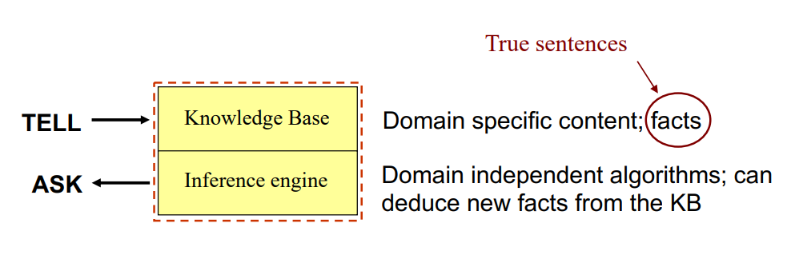
Agent that think rationally
Knowledge based agent

Slide 10
Agent that think rationally
Architecture of Knowledge based agent
Knowledge level:
  Most abstract: describe agent by what it knows
  Ex: Autonomous vehicle knows Golden Gate Bridge connects San Francisco with the Marin County
Logical Level:
  Encoding of knowledge in a formal language.
  Ex: links(GoldenGateBridge, SanFran, MarinCounty)
Implementation Level:
  The internal representation of the sentences e.g.
  (links goldengatebridge sanfran marincounty)

Slide 11
Fundamental concept of logic
concepts
Syntax
  Grammar / rules to follow for form a well-defined sentence
  X + Y = 4 is a valid sentence in “arithmetics”, x4y+= is not.
Semantics:
  The meaning of sentences. Truth of each sentence w.r.t. each possible world.
  Possible World 1: x=3, y=1. Possible World 2: x=1, y=1.

Slide 12
Fundamental concept of logic
concepts
Model (Possible world, a.k.a. “interpretations” in some text)
  Each model is an assignment of values to variables.
  Each model fixes the truth value of all sentences
  If sentence 𝛼 is true in Model 𝑚, we say: Model 𝑚 satisfies sentence 𝛼, or 𝑚 is a model of 𝛼, or 𝑚 ∈ 𝑀(𝛼),

Slide 13
Fundamental concept of logic
concepts
Entailment:
  Sentence 𝛽 logically follows from Sentence 𝛼
  Denoted by 𝛼 ⊨ 𝛽
  𝛼 entails 𝛽 if an only if 𝑀(𝛼) ⊆ 𝑀(𝛽)
  If all models of 𝛼 are also models of 𝛽
Logical Inferences:
  The procedure of checking whether a sentence is entailed by a given a knowledge base
  Simplest algorithm for logical inference: Model checking

Slide 14
Fundamental concept of logic
concepts
Model (Possible world, a.k.a. “interpretations” in some text)
  Each model is an assignment of values to variables.
  Each model fixes the truth value of all sentences
  If sentence 𝛼 is true in Model 𝑚, we say: Model 𝑚 satisfies sentence 𝛼, or 𝑚 is a model of 𝛼, or 𝑚 ∈ 𝑀(𝛼),

Slide 15
Fundamental concept of logic
Concepts
Given a set of (true) sentences, logical inference generates new sentences:
  Sentences 𝛼 follow from 𝛽𝑖
  Sentences {𝛽𝑖 } entail sentence 𝛼
  A knowledge base (KB) entails sentence 𝛼 (KB ⊨ 𝛼)

Slide 16
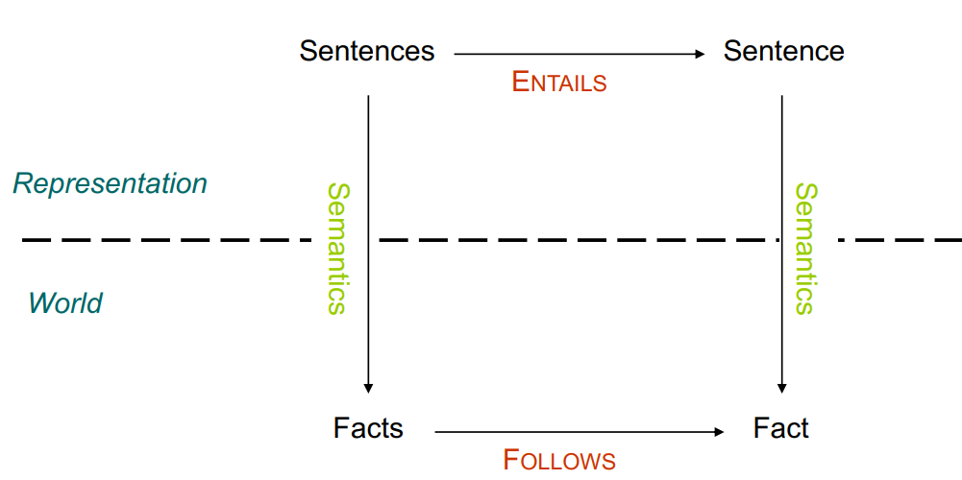
Fundamental concept of logic
Concepts
Inference:
  The act or process of deriving logical conclusions from premises known or assumed to be true.
  The act of reasoning from factual knowledge or evidence

Slide 17
Inference
Inference engine
An inference engine is a program that applies inference rules to knowledge
  Goal: To infer new (and useful) knowledge
Separation of
  Knowledge
  Rules
  Control
Inference Engine

Slide 18
Inference
Inference procedure
An inference procedure
  Generates new sentences a that significance to be entailed by the knowledge base
  Or
  Reports whether or not a sentence a is entailed by the knowledge base
Not every inference procedure can derive all sentences that are entailed by the KB
A sound or truth-preserving inference procedure generates only entailed sentences
Inference derives valid conclusions independent of the semantics (i.e., independent of the models)

Slide 19
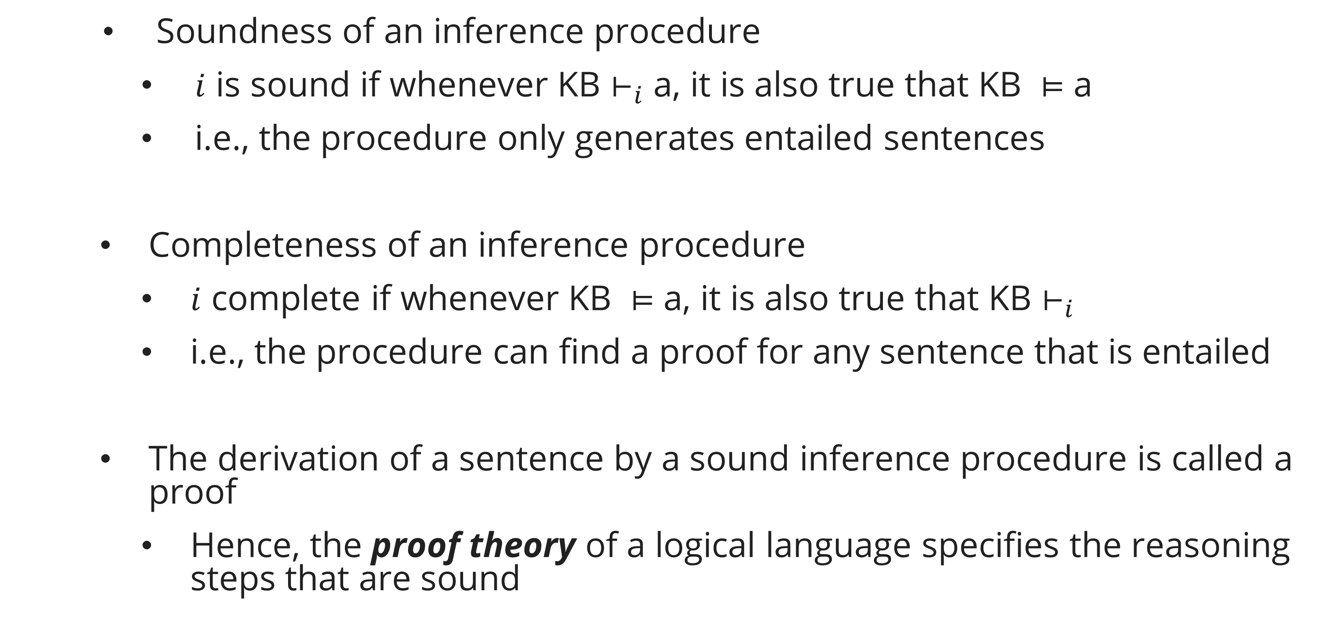
Inference
Inference procedure
Soundness of an inference procedure
    $i$ is sound if whenever KB $⊢_{i}$ a, it is also true that KB $⊨$ a
    i.e., the procedure only generates entailed sentences
Completeness of an inference procedure
  $i$ complete if whenever KB $⊨$ a, it is also true that KB $⊢_{i}$
  i.e., the procedure can find a proof for any sentence that is entailed
The derivation of a sentence by a sound inference procedure is called a proof
  Hence, the proof theory of a logical language specifies the reasoning steps that are sound

Slide 20
Propositional logic
Intuition
Propositional logic is the logic of propositions
a proposition can be true or false in the state of the world.
The same proposition can be expressed in different ways e.g
  “Taylor swift is writing a song”
  “the female singer is writing a song”
The language of propositional logic allows us to express propositions.

Slide 21
Propositional logic
propositions
Example (Propositions):
  Today is Monday.
  Every even number has at least two factors.
Example (Not Propositions):
  Do your homework!
  When is the pretest?

Slide 22
Propositional logic
Propositional logic languages
Definition (Propositional alphabet):
  Logical symbols: ¬, ∧, ∨,→, ↔,≡
  Non-Logical Symbol: A set 𝑃 of symbols called propositional variables
  Separator symbols “(” and “)”
Definition (Well formed formulas):
  Every 𝑃∈𝑃 is an atomic formula
  Every atomic formula is a formula
  If A and B are formulas then ¬𝐴, 𝐴∧𝐵, 𝐴∨𝐵, 𝐴→𝐵,𝐴↔𝐵, 𝑒𝐴 ≡𝐵 are formulas

Slide 23
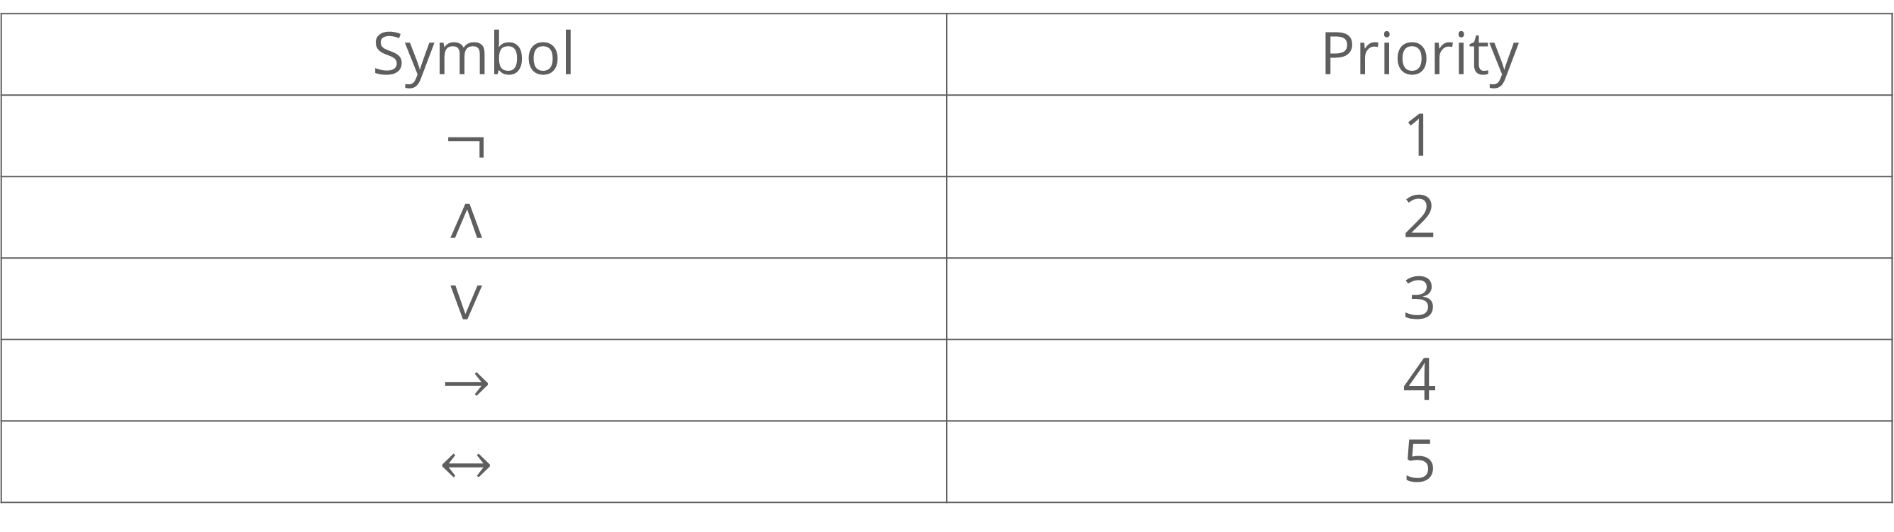
Propositional logic
Reading formula
How do we read the formula 𝑃 ∧ 𝑄 → 𝑅?
The Formula 𝑃 ∧ 𝑄 → 𝑅 can be read in two ways:
(𝑃 ∧ 𝑄) → 𝑅 𝑃 ∧ (𝑄 → 𝑅)
Symbol priority:
Symbol | Priority
$$¬$$ | 1
$$∧$$ | 2
$$∨$$ | 3
$$→$$ | 4
$$↔$$ | 5

Slide 24
Propositional logic
Reading formula
Furthermore, binary connectives are right associative, e.g.:
𝑎 → 𝑏 → 𝑐 read as 𝑎 → (𝑏 → 𝑐)
𝑎 ∧ 𝑏 ∧ 𝑐 read as 𝑎 ∧ (𝑏 ∧ 𝑐)

Slide 25
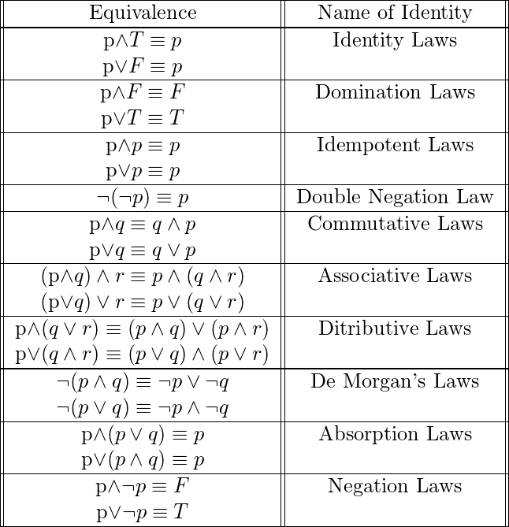
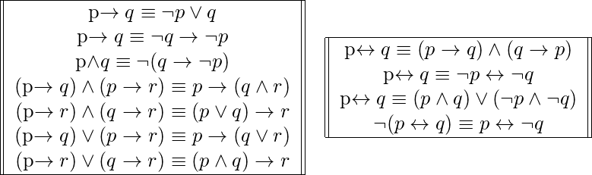
Propositional logic
Propositional equivalence

Slide 26
Propositional logic
Satisfiability and validity
Is this true: (𝑃 ∧𝑄)?
  It depends on the values of P and Q
  This is a satisfiable sentence – there are some models for which it is true and others for which it is false
Is this true: (𝑃 ∧¬𝑃)?
  No, it is never true
  This is an unsatisfiable sentence (self-contradictory) – there is no models for which it is true
Is this true: (((𝑃 ∨𝑄)∧¬𝑄)→𝑃)?
  Yes, independent of the values of P and Q
  This is a valid sentence – it is true under all possible models (a.k.a. a tautology)

Slide 27
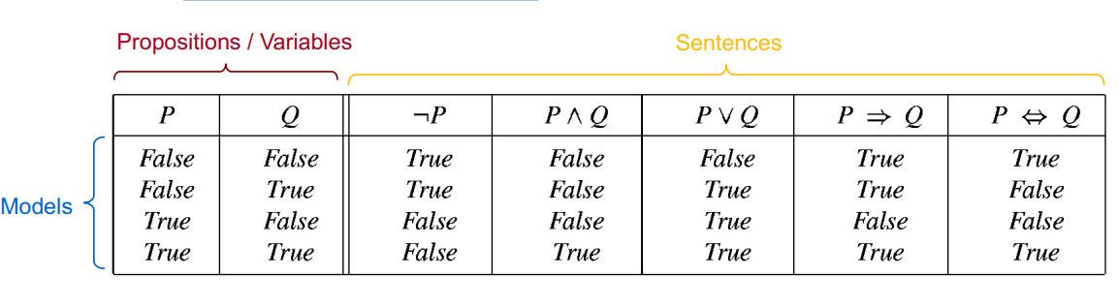
Propositional logic
Semantic
Defined by clearly interpreted symbols and straightforward application of truth tables
Rules for evaluating truth: Boolean algebra
Simple method: truth tables

Slide 28
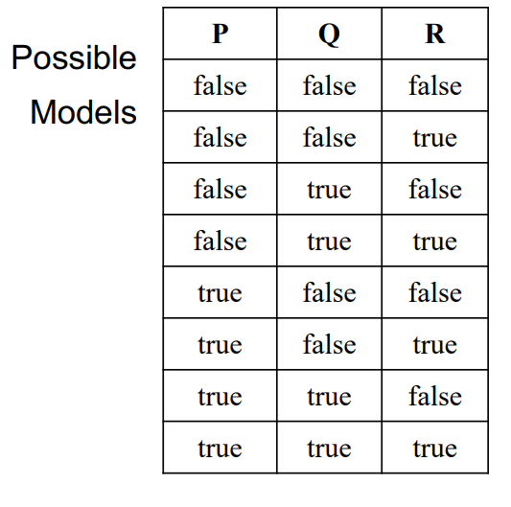
Propositional logic
Knowledge are constraints that eliminate rows
Adding a sentence to our knowledge base constraints the number of possible models
Example:
When KB = Empty

Slide 29

Propositional logic
Knowledge are constraints that eliminate rows
Adding a sentence to our knowledge base constraints the number of possible models
Example:
When KB = $\left(\left(P∧¬Q\right)∨\left(Q∧¬P\right)\right)→R$
Because with current KB, those rows output False

Slide 30

Propositional logic
Knowledge are constraints that eliminate rows
Adding a sentence to our knowledge base constraints the number of possible models
Example:
When KB = $\left(\left(P∧¬Q\right)∨\left(Q∧¬P\right)\right)→R,R$
The added KB is $R$, so we only focus when $R$ is True

Slide 31
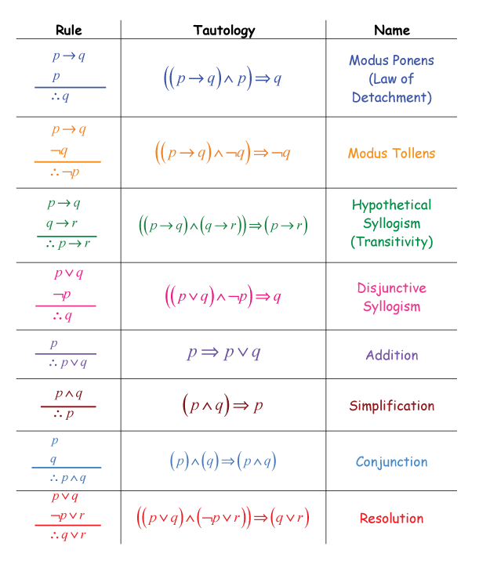
Propositional logic
Rules of inference
Inference rules capture patterns of sound inference
Once established, don’t need to show the truth table every time

Slide 32
Propositional logic
Rules of inference: example
If it rains, then John wears a coat
If John wears a coat, then he is not cold
It is raining
The Syntax:
  J: John wears coat
  R: it is rains
  C: John is Cold
Therefore:
  If it rains, then John wears a coat (𝑅 → 𝐽)
  If John wears a coat, then he is not cold (𝐽 → ¬𝐶)
  It is raining (𝑅 )

Slide 33

Propositional logic
Rules of inference: example
If it rains, then John wears a coat $(R → J)$
If John wears a coat, then he is not cold $(J → ¬C)$
It is raining $(R )$
    The Conclusion using Rule of Inference:
    $(R → J)$ Given
    $(J → ¬C)$ Given
    R Given
    J Modus Ponen (1, 3)
    $¬C$ Modus Ponen (2, 4)
    The conclusion: John is not cold

Slide 34
Limitations of Propositional logic
Rules of inference: example
Propositional logic has simple syntax and semantics, and limited expressiveness
  Though it is handy to illustrate the process of inference
However, it only has one representational device, the proposition, and cannot generalize
  Input: facts; Output: facts
  Result: Many, many rules are necessary to represent any nontrivial world
  It is impractical for even very small worlds
The solution?
  First-order logic, which can represent propositions, objects, and relations between objects
  Worlds can be modeled with many fewer rules

Slide 35
exercise
Mewing case
In the town of Meowington, Whiskers Purr-ot, the cat detective, is investigating the mysterious disappearance of Lady Tabby's diamond collar. There are three suspects: Mittens, Clawdia, and Tigger. Only one suspect tells the truth, and the thief must be among them.
The premises are as follows:
  If Mittens was in the garden, then Clawdia was in the parlor.
  Tigger or Clawdia has the diamond collar, but they both claim not to have it.
  Tigger says that he was sleeping in the attic when the collar went missing.
  If Clawdia has the diamond collar, she must have been in the parlor.
  Mittens claims that if he had taken the collar, he would not be hiding in the bushes.
  It is known that the cat with the collar was not sleeping.
Determine who took Lady Tabby's diamond collar using the premises given.

Slide 36
References
Session 7
Burgard, W., Nebel, B., & Riedmiller, M. (2014). Propositional Logic Rational Thinking, Logic, Resolution. Foundations of Artificial Intelligence. https://gki.informatik.uni-freiburg.de/teaching/ss14/gki/lectures/ai07.pdf
Ferraro, F. (2021). Propositional and First-Order Logic. CMSC 471: Artificial Intelligence. https://redirect.cs.umbc.edu/courses/undergraduate/CMSC471/spring21/03/slides/05-logic.pdf
Rosen, K. H. (2012). Discrete mathematics and its applications (7th ed). McGraw-Hill.
Russell, S. J., Norvig, P., Chang, M., Devlin, J., Dragan, A., Forsyth, D., Goodfellow, I., Malik, J., Mansinghka, V., Pearl, J., & Wooldridge, M. J. (2022). Artificial intelligence: A modern approach (Fourth edition, global edition). Pearson.
Serafini, L. (2023). Propositional Logic—Syntax and Semantics. Knowledge Representation and Learning. https://stem.elearning.unipd.it/pluginfile.php/480526/mod_resource/content/2/slides.pdf
Wang, Y.-X. (2020). Logic: Logic intro & Propositional Logic. CS165A: Artificial Intelligence (Fall 2020). https://sites.cs.ucsb.edu/~yuxiangw/classes/CS165A-2020fall/Lectures/Lecture-logic1.pdf

